Slide 1
Career Pathway – In-class activity
Notes:
Hey there folks, hope you’re having a wonderful whatever time of day it is, and welcome to a short look on the fabulous life of a Software Development Engineer!

Slide 2
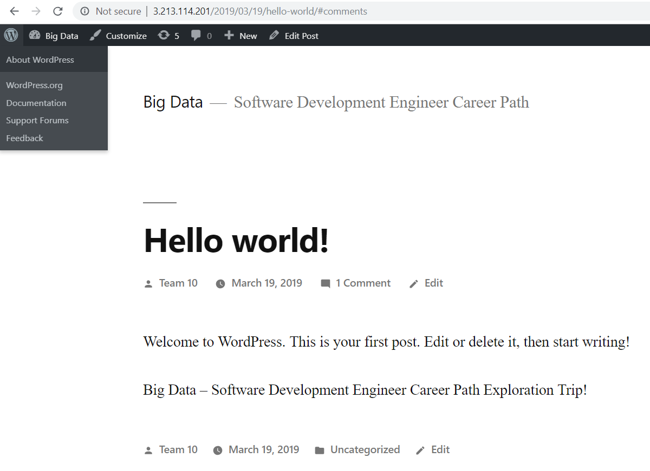
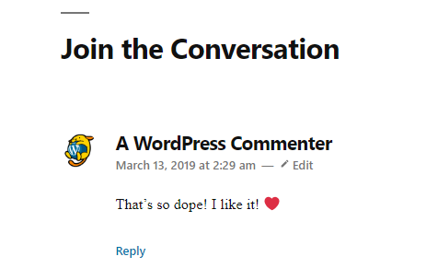
In class activity
Starting Point of Software Development Engineer
Building your own website using EC2& Route 53
•Step 1: Launch an Amazon EC2 Instance
•Step 2: Configure your Instance
•Step 3: Make Changes to Your Website ($0)
Register a Domain Name with Amazon Route 53
•Step 1: Obtain a Static URL ($0 or $0.005/h)
•Step 2: Register a Domain Name (.com $12)
•Step 3: Configure DNS

Slide 3
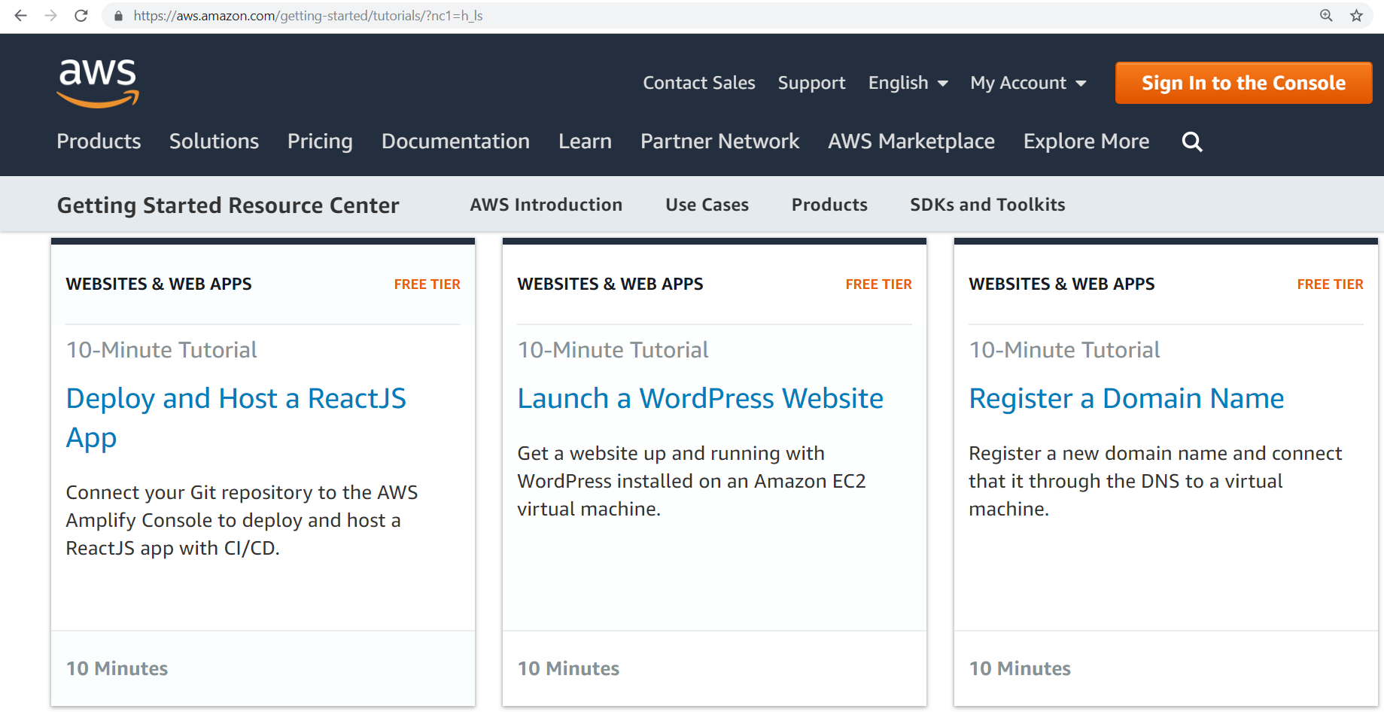
Building Your Own Website - hint
https://aws.amazon.com/getting-started/tutorials/?nc1=h_ls

Slide 4
Building Your Own Website
Launch a WordPress Website with Amazon EC2
•Step 1: Launch an Amazon EC2 Instance
•Step 2: Configure your Instance
•Step 3: Make Changes to Your Website ($0)
Register a Domain Name with Amazon Route 53
•Step 1: Obtain a Static URL ($0 or $0.005/h)
•Step 2: Register a Domain Name (.com $12)
•Step 3: Configure DNS

Slide 5
Building Your Own Website
Launch a WordPress Website with Amazon EC2
•Step 1: Launch an Amazon EC2 Instance
•Step 2: Configure your Instance
•a. AWS Marketplace - WordPress
•b. detailed pricing page
•c. free-tier eligible t2.micro instance
•d. We will set a name for your instance
•e. start your Amazon EC2 instance running WordPress
•f. proceed without a key pair
•g. view Instances
•h. test WordPress website and see a Hello World blog page appear
•Step 3: Make Changes to Your Website
•a. EC2 management console-Actions-Instance Setting-Get System Log
•b. find the password that's surrounded by hash marks
•c. access the WordPress Hello World admin page and manage your Website ($0)

Slide 6
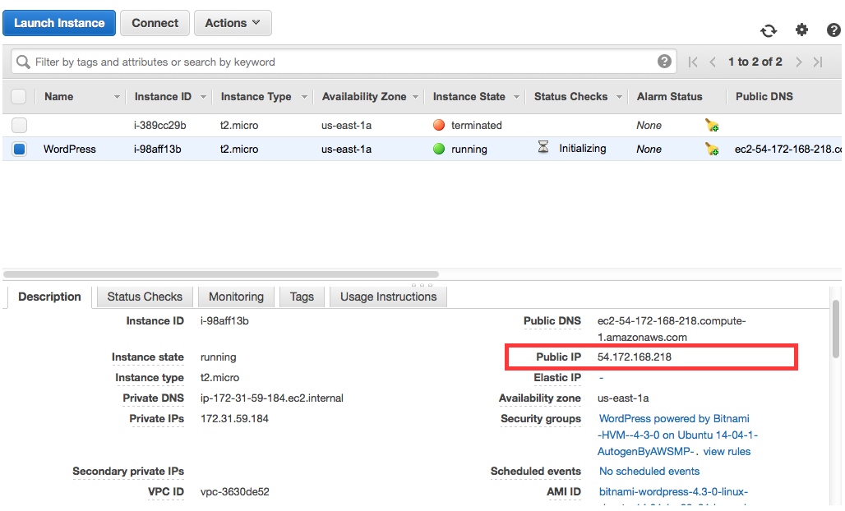
Building Your Own Website
Amazon EC2

Slide 7
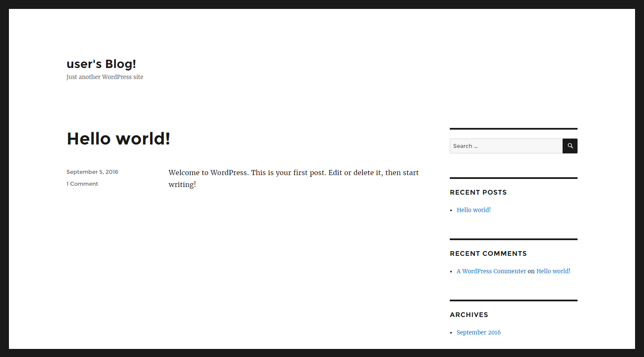
Building Your Own Website
WordPress

Slide 8
Building Your Own Website
Register a Domain Name with Amazon Route 53
•Step 1: Obtain a Static URL ($0 or $0.005/h)
•a. open the Elastic IPs part of the EC2 console
•b. Set EIP used in: to VPC and click Yes, Allocate
•c. Note your new IP address
•d. Select the new IP address with the Associate Address option
•e. Instance text box and choose instance name
•f. Verify that your new Elastic IP address is working
•Step 2: Register a Domain Name (.com $12)
•a. open the Route 53 console (AWS’s DNS service)
•b. Register Domain button
•c. Enter your Contact Details
•d. Complete purchase
•Step 3: Configure DNS

Slide 9
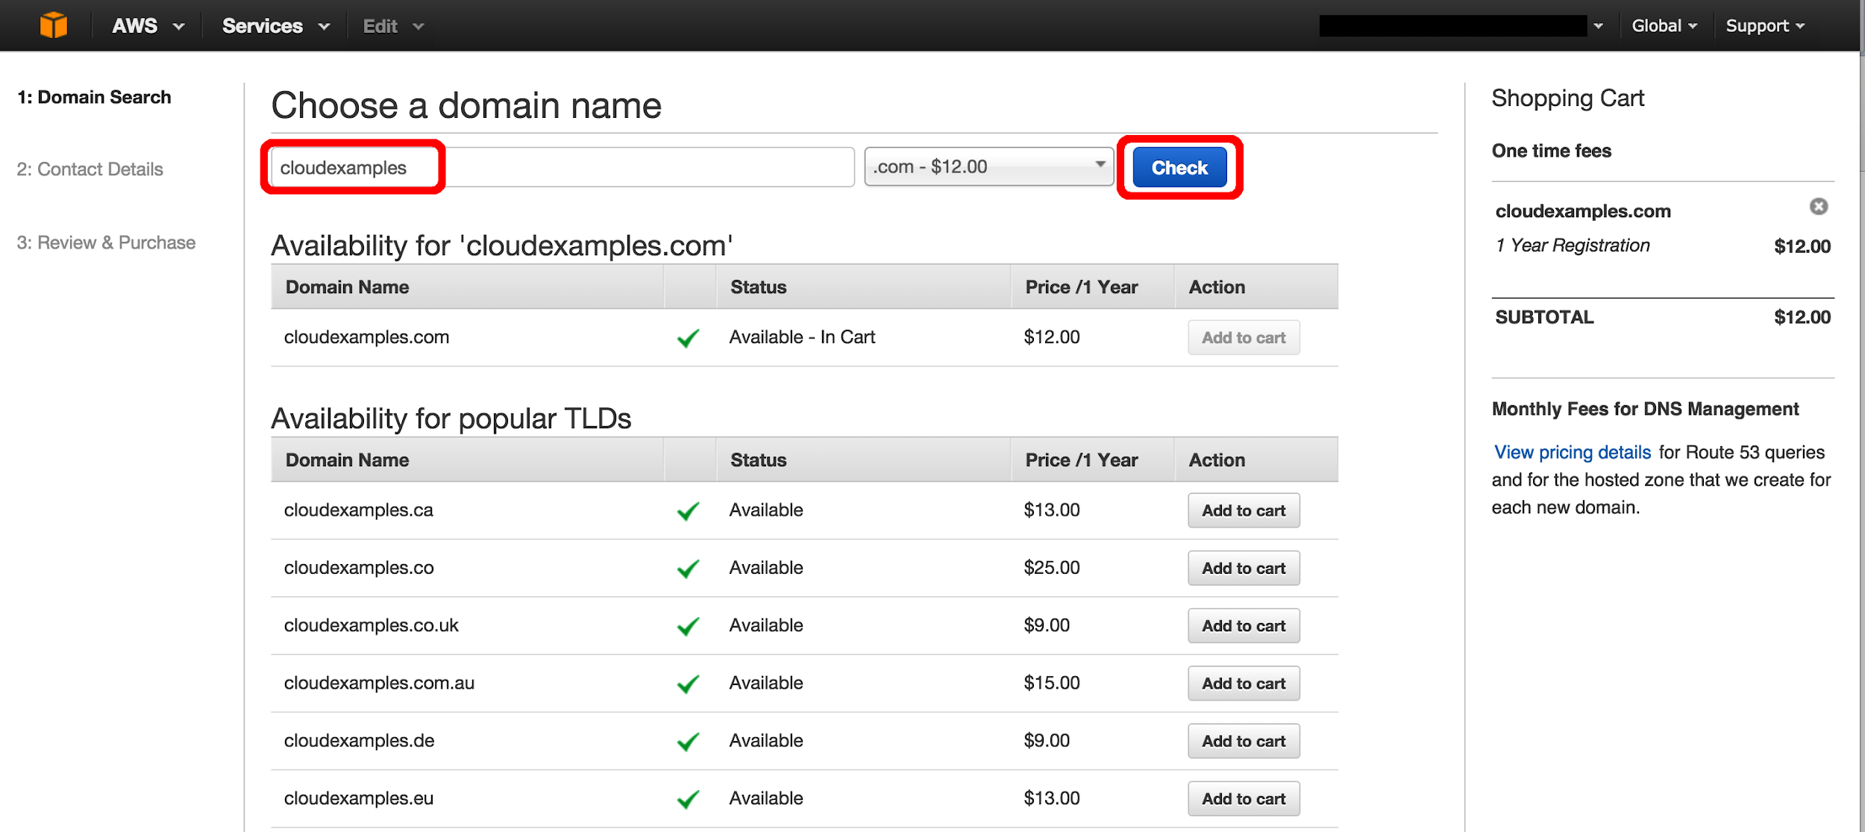
Building Your Own Website
Amazon Route 53

Slide 10
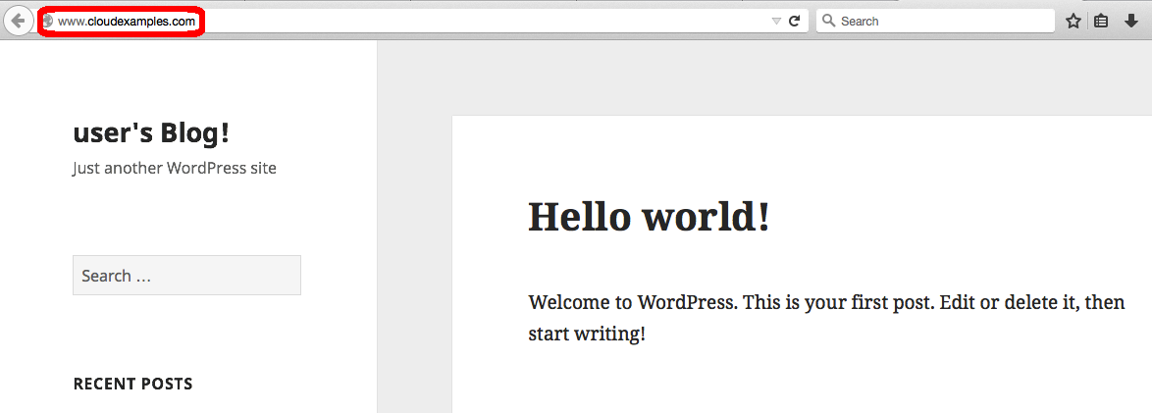
Building Your Own Website
WordPress

Slide 11

Thanks for watching!
In-class activity
https://www.youtube.com/watch?v=3B4ih3k7XPA
Notes:
Thanks for watching, and now we’re going to lead into a short exercise that will help you showcase skills to employers on your journey of becoming a software developer!

